Slide 1
Properties of Fresh Concrete
Notes:
The quality of PCC depends on the quality of individual components but also on the concrete production process. The production process consists or mixing, transporting, placing, compacting, and curing. The workability of the concrete must be adjusted for the method of placement (pumping, vibration screed, etc.) and the climatic conditions at the time of placement. The discussion of the concrete properties involves both the fresh and hardened states.

Slide 2
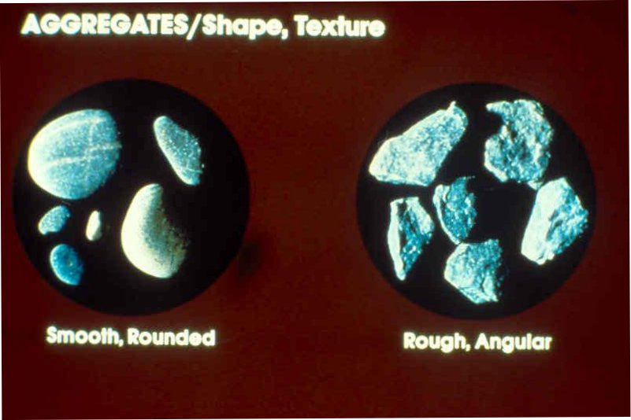
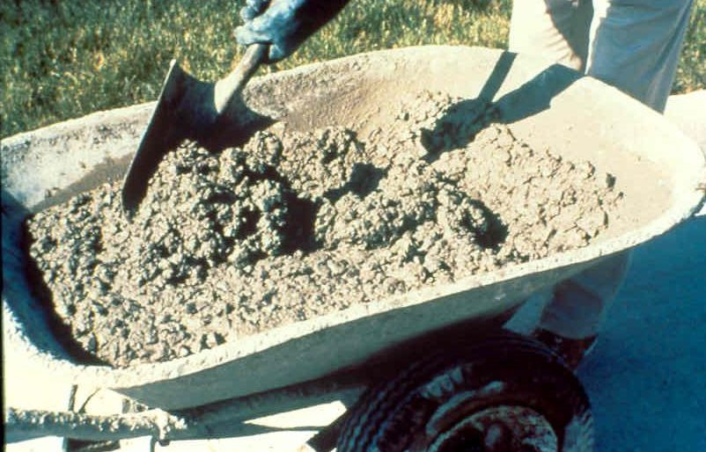

Slide 3
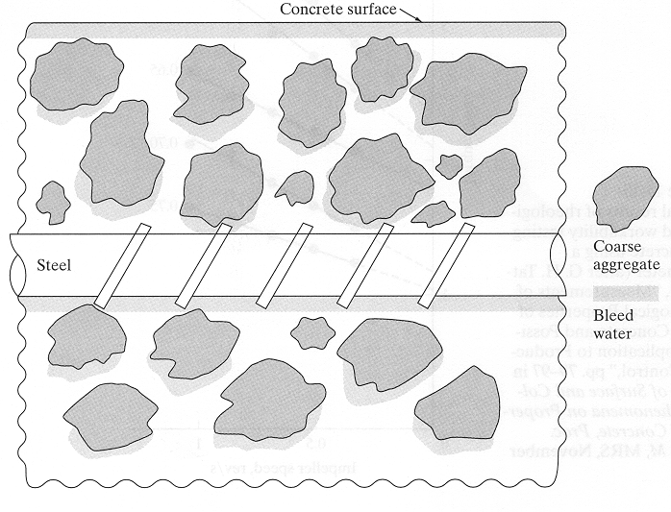
Notes:
During the placing process, the aggregates tend to settle in the form which force any free moisture to move upwards towards the top surface of the finished concrete. This effect is known as bleeding. Bleeding should be held to a minimum but needs to be sufficient to prevent plastic shrinkage cracking. Concrete in the fresh state must also be workable enough to conform to a variety of placing and finishing conditions on the job site.

Slide 4
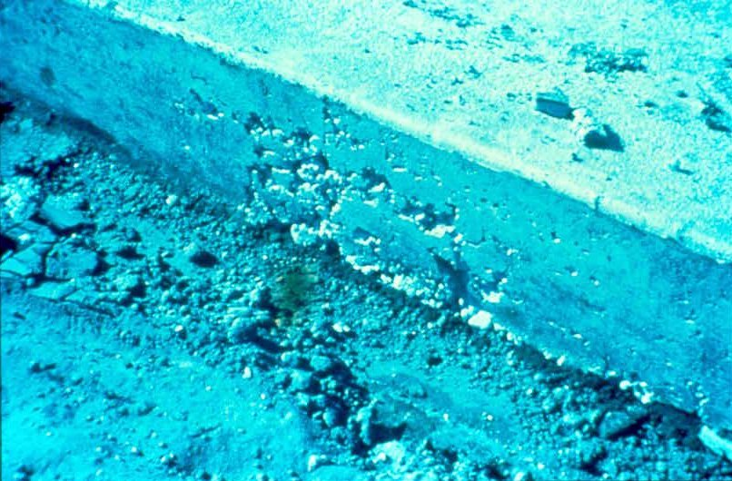


Slide 5
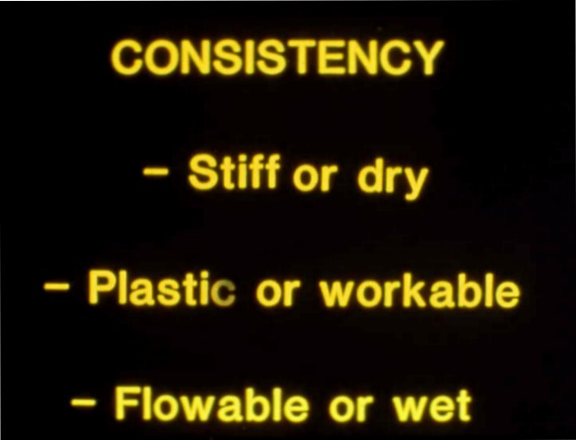
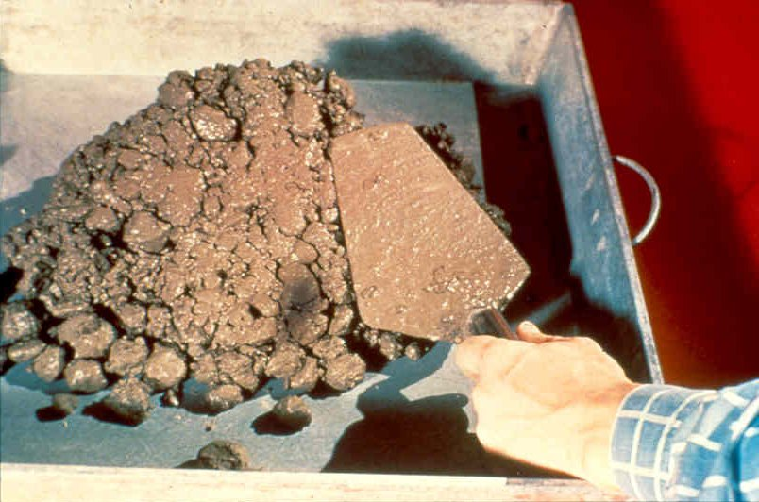
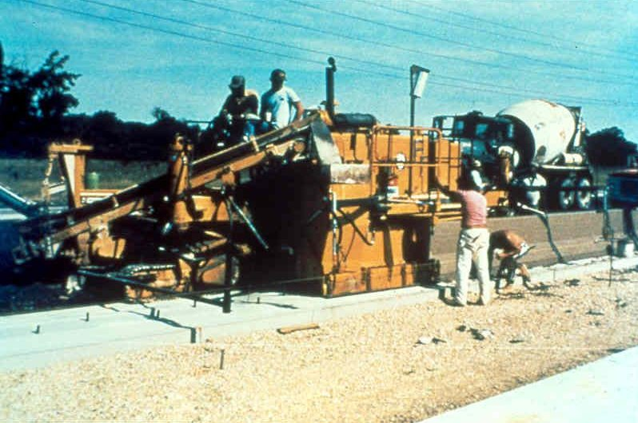
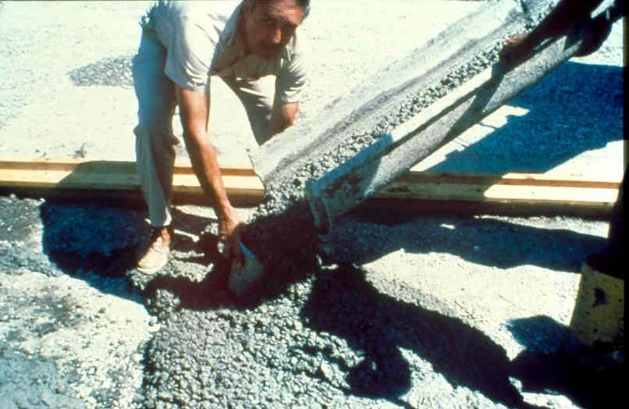

Slide 6
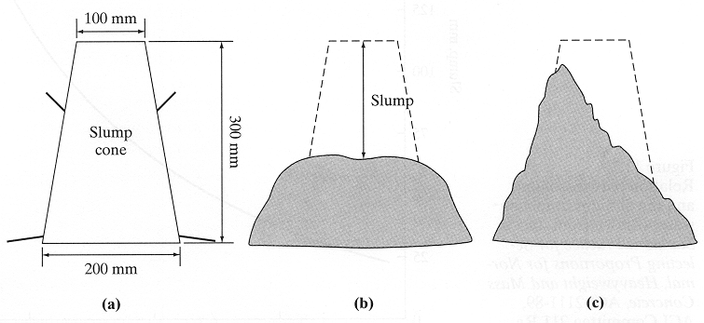
The Slump Test - ASTM C 143
Notes:
The slump test does give some indication of segregation. If the slump is sheared and collapsed, rather than sagged evenly, then segregation and bleeding should be expected of the fresh concrete. The addition of more sand or cement should help provide a greater amount to consistency and cohesiveness to the mixture. Cohesiveness may wane if too much water is added to the mixture.

Slide 7
Mixture Design
For a paving project with a 9 inch slab and a minimum strength of 3000 psi, determine using ACI 211:
1) the w/cm
2) the slump
3) # of sacks of cement
4) the CAF
Assume:
  FM = 2.9
  Agg Size = 1.0 in

Slide 8
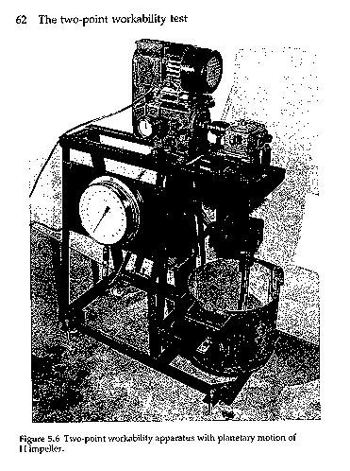

Slide 9
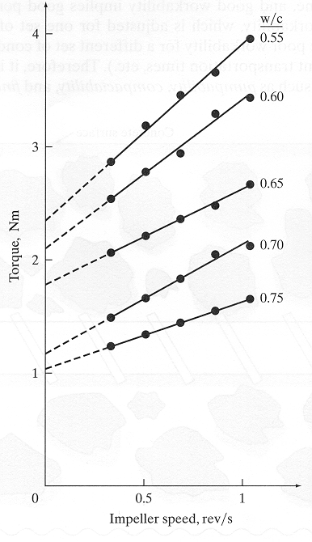
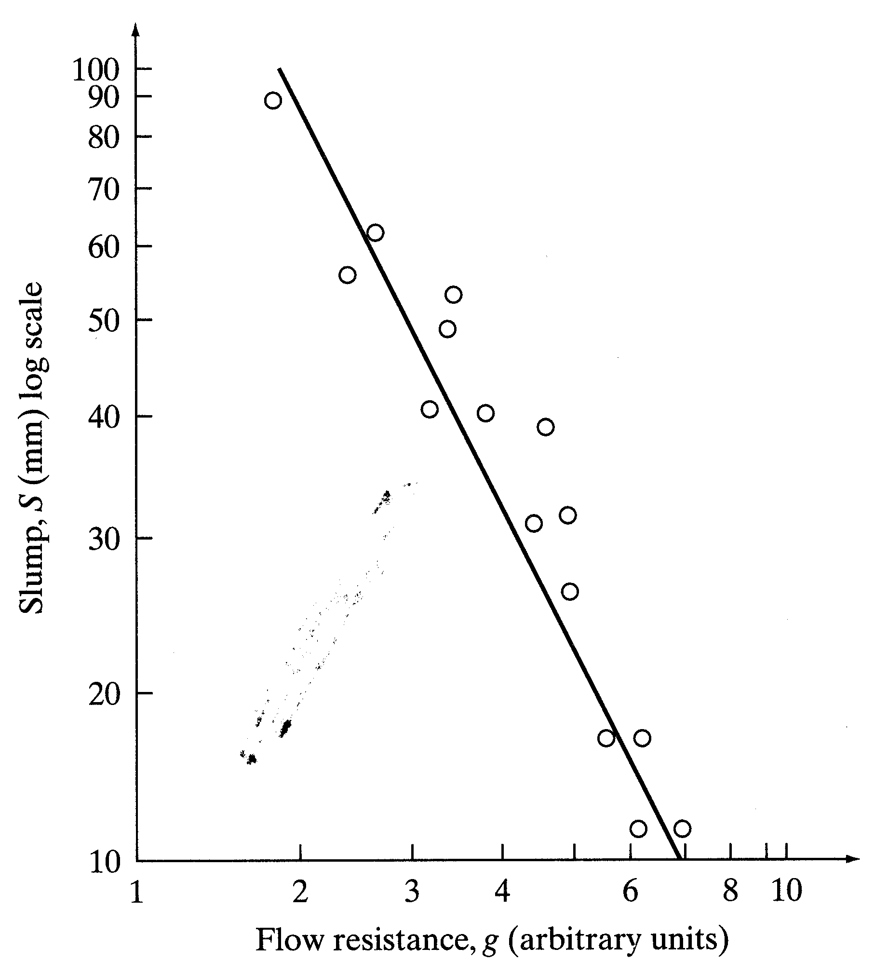
T = g + h N
T is the torque
N is the impeller rotational speed
g - flow resistance
h - torque viscosity

Slide 10
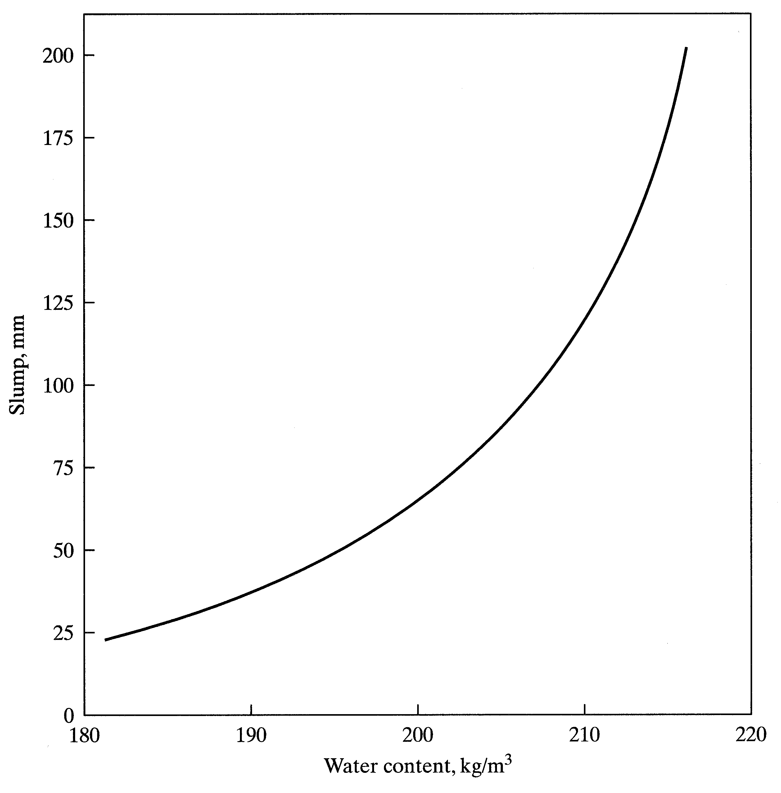
Amount of Mixing Water
Notes:
The relationship between slump and water content is not linear, and a small increase in the water content in the wetter mixtures will result in a larger increase in slump than in the stiffer mixtures.

Slide 11
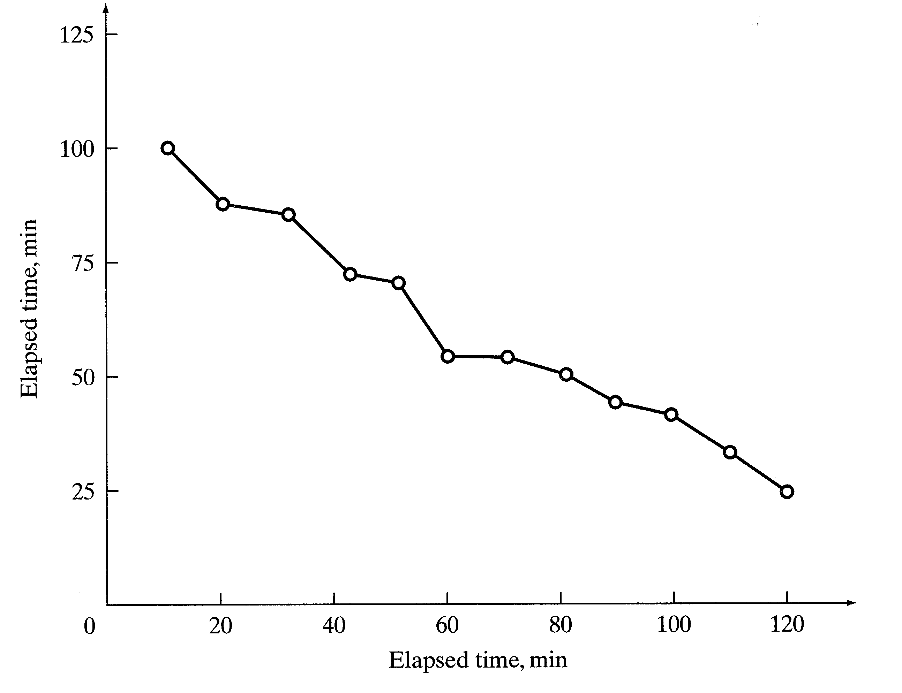
% Loss of Slump
Notes:
Slump loss occurs due to a reduction in free water in the mixture (because of absorption in the aggregates or hydration of the cement) and partly due to evaporation. This effect causes the slump to decrease with time. This is more of a concern during placement in hot weather. Slump loss affects the time available to place and to finish the concrete.

Slide 12
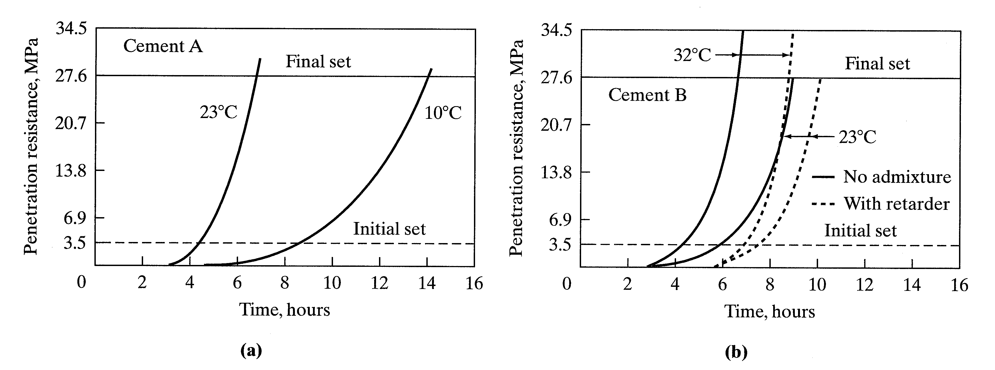
Concrete Setting Behavior
Notes:
Concrete shrinkage:
Plastic drying shrinkage - occurs is the evaporation rate exceeds the bleed rate. Shrinkage is controlled to some extent through curing. Curing is the process of maintaining proper moisture levels in concrete during the hardening stages. Several methods are available for curing.
Drying shrinkage - occurs for an extended period of time after the concrete has begun to take on a certain amount of rigidity.
Concrete setting is determined using a laboratory procedure outlined in ASTM C 403. This determines the resistance of the concrete to penetration of a standard probe as a function of time. The procedure itself is rather arbitrary, nonetheless it does provide some insight into the setting behavior concrete. Initial set represents the time when the concrete is nearly capable of supporting human traffic. Final setting is where the concrete begins to develop residue states of stress; it has some compressive strength but zero tensile strength.

Slide 13
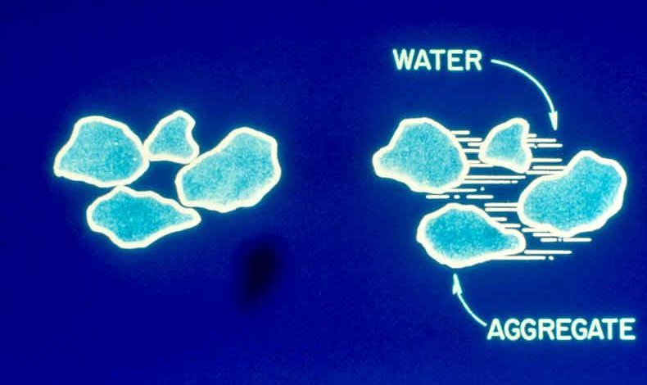
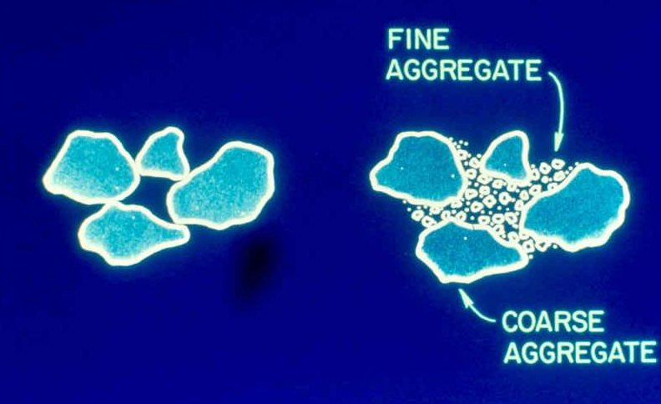
Water and Aggregate Effects

Slide 14
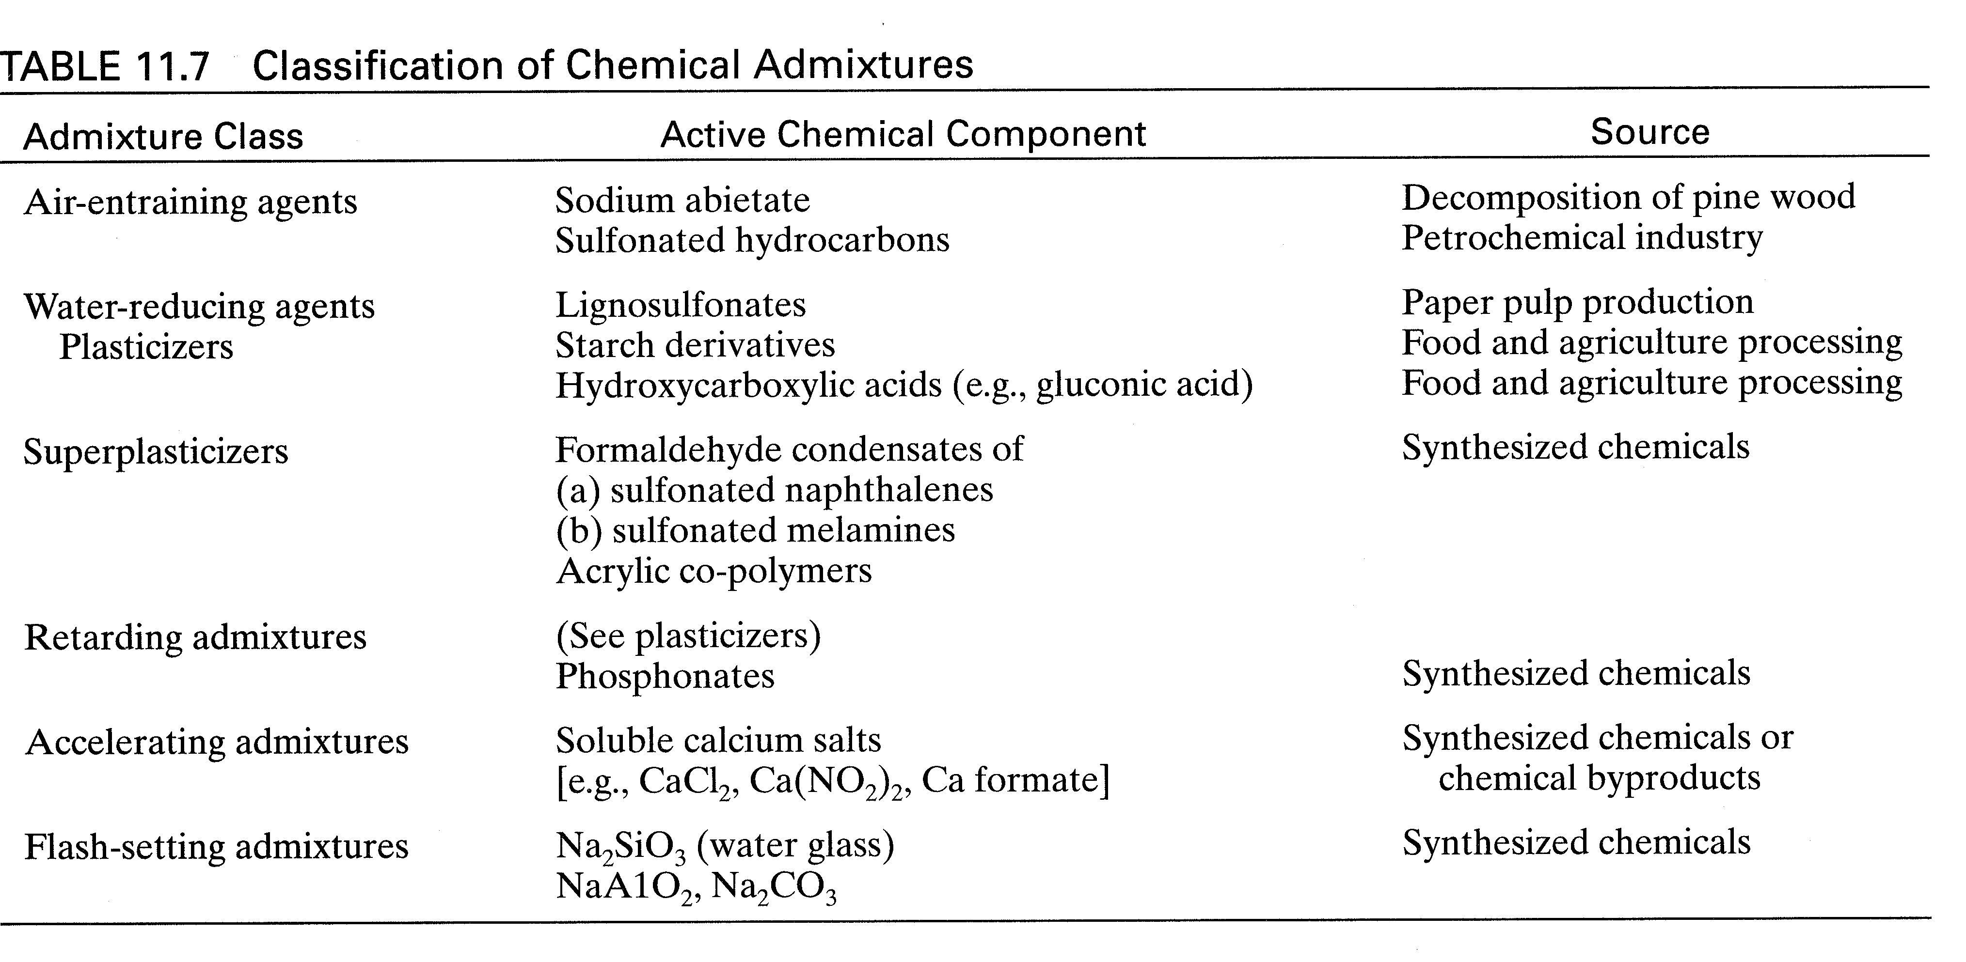
Chemical Admixtures
Notes:
Water-reduction Admixtures
These are surfactants. See next figure. They prevent the cement grains from flocculating in water. More water is available for lubrication the mix and the flow properties are enhanced. These admixtures can be used to reduce the water content. A reduction in w/c will increase strength, lower permeability, and improve durability. They also retart the set time to some extent. The rate of slump loss may also be affected.
Set-retarting Admixtures
These admixtures slow down early hydration and the rate of strength development. May not affect the rate of slump loss.
Accelerating Admixtures
These admixtures accelerate the early hydration process by increasing the calcium ion concentration of the pore water solution. The also affects the hardening stage as well. These admixtures are commonly used in repair work or in other applications where early strength is required. Both chloride and non-chloride accelerators are available.

Slide 15
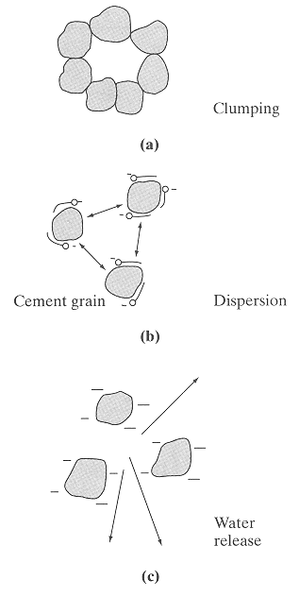
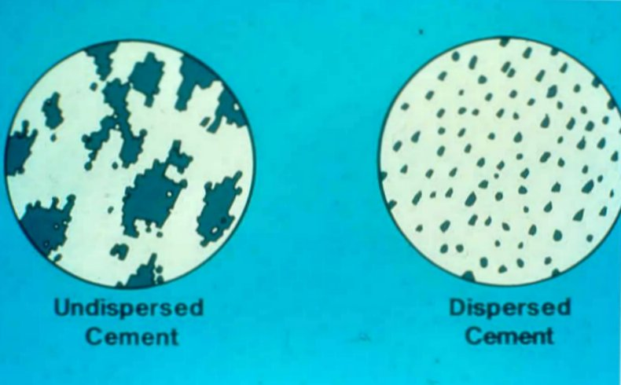
Water Reduction

Slide 16
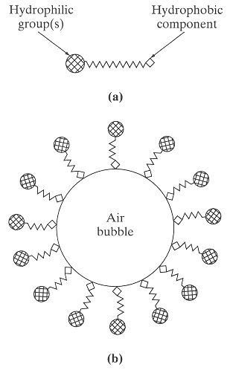

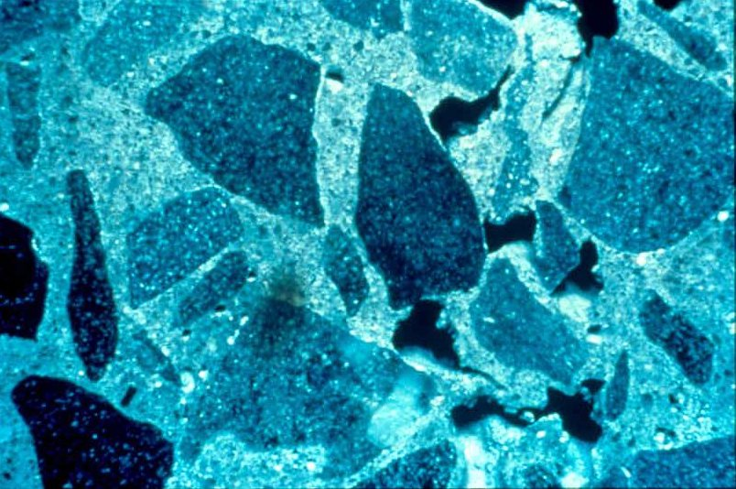
Notes:
Air-entraining Admixtures
These admixtures acts as surfactants at the air-water interface and work to trap air in individual bubbles. The bubbles must be stabilized within the hardened paste. The tiny bubbles act as reservoirs to accommodate water expelled from the capillary pores during freezing action. Air entrainment will increase workability (especially if fly ash is used) and reduce bleeding action. As long as the air content is below 6%, little loss of strength is experienced. Although there is some concern over compatibility in mixtures containing multiple admixtures, a greater concern exists relative to dosage rates.

Slide 17
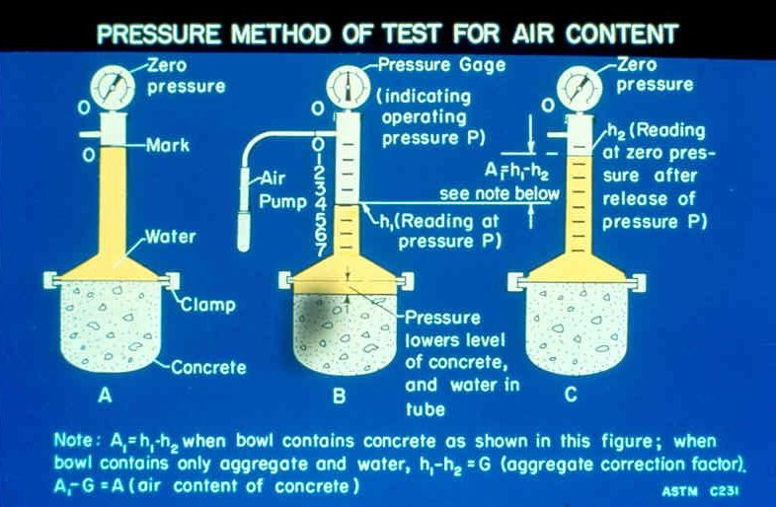
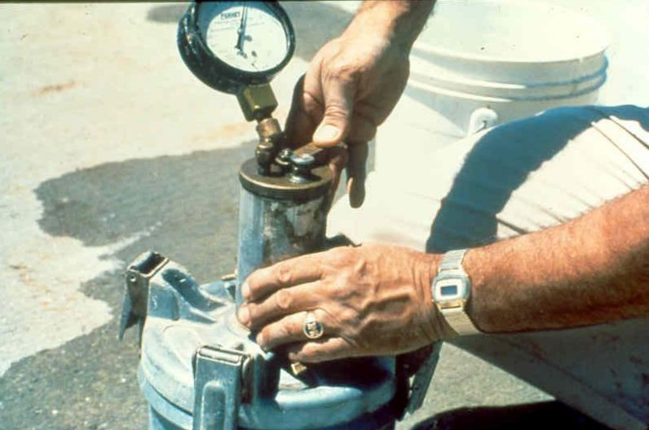
Testing for
Air Content

Slide 18
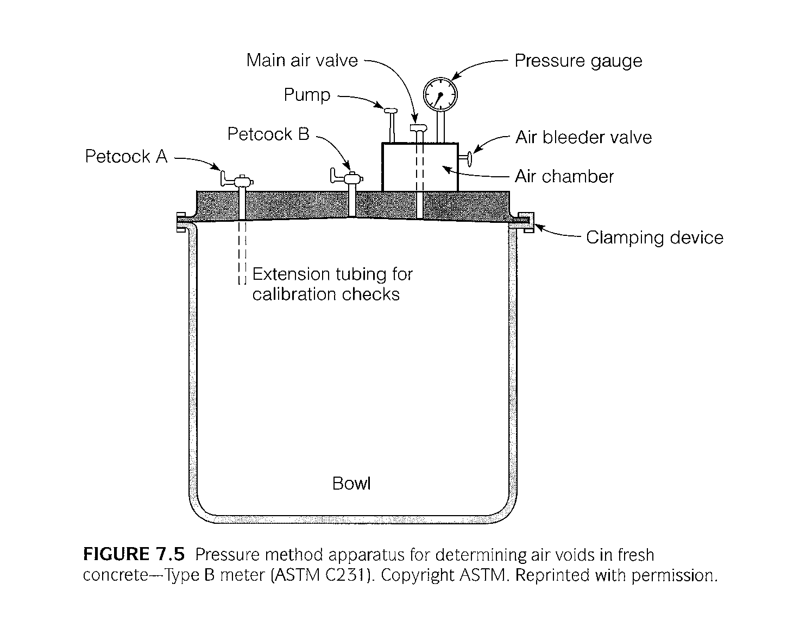
Type B Pressure Meter

Slide 19
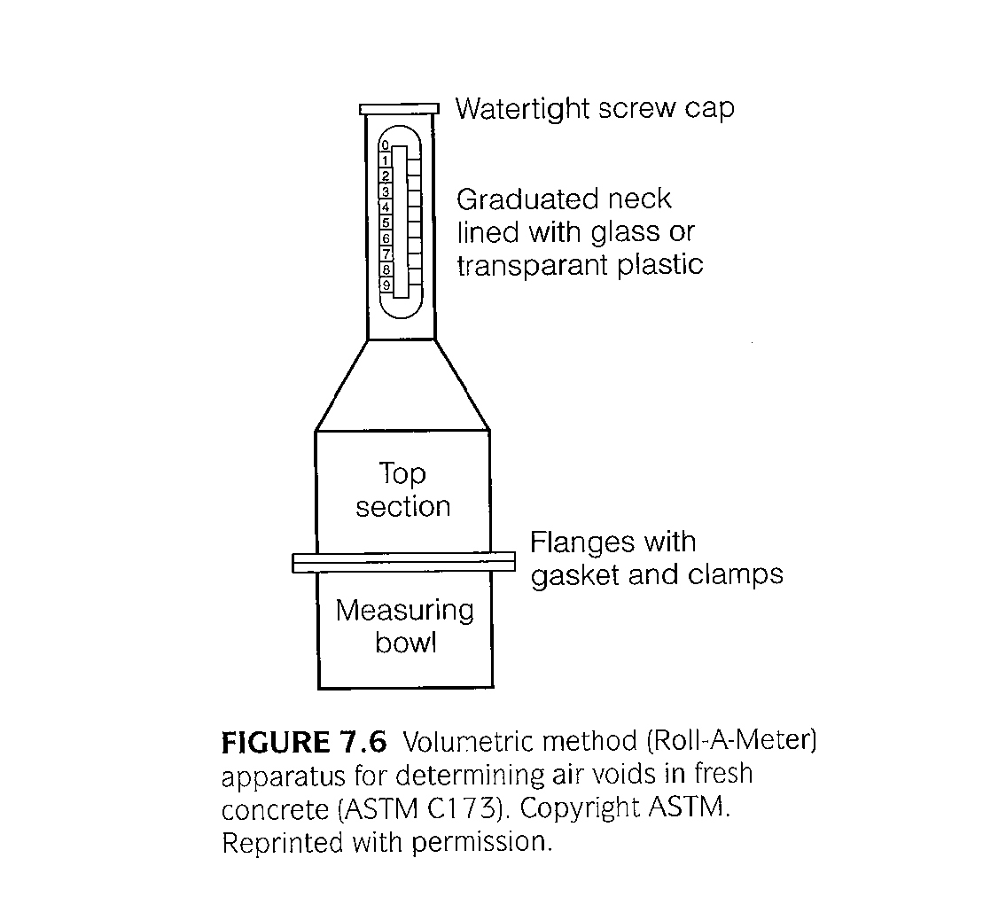
Roll-a-Meter

Slide 20
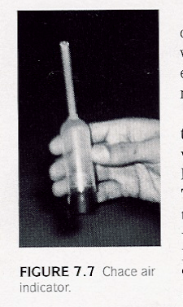
Chace Air Indicator

Slide 21
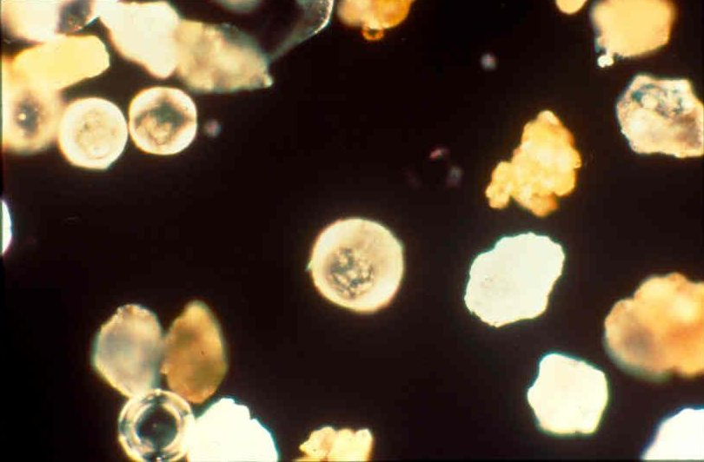
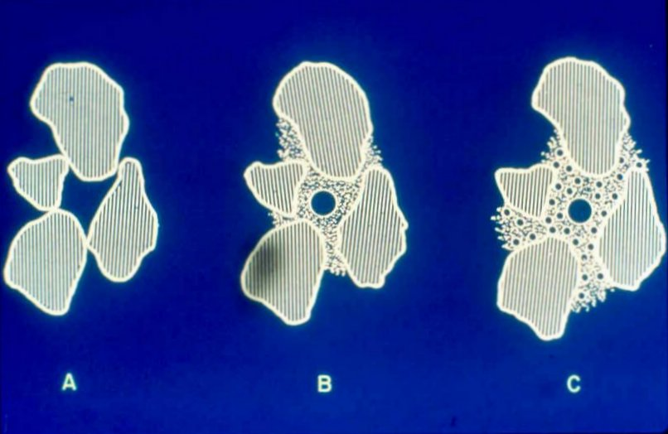
Fly Ash and Air Content Effects

Slide 22
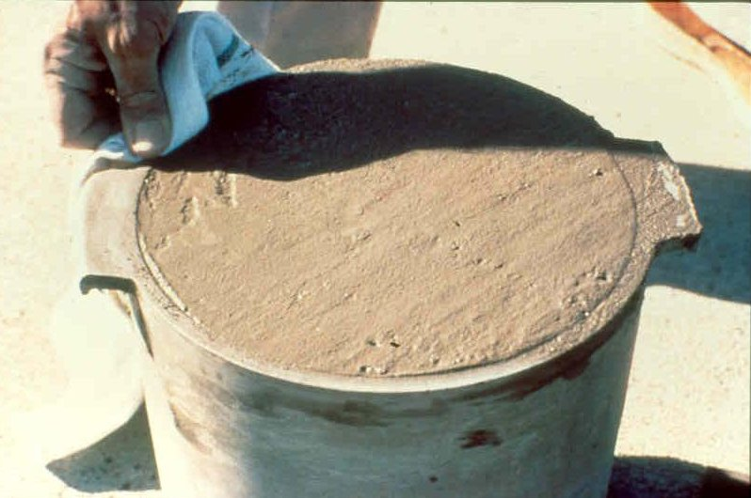
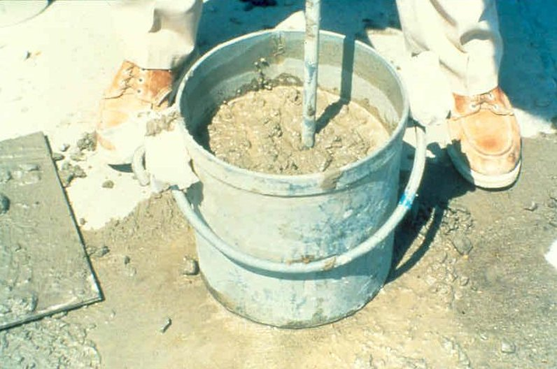
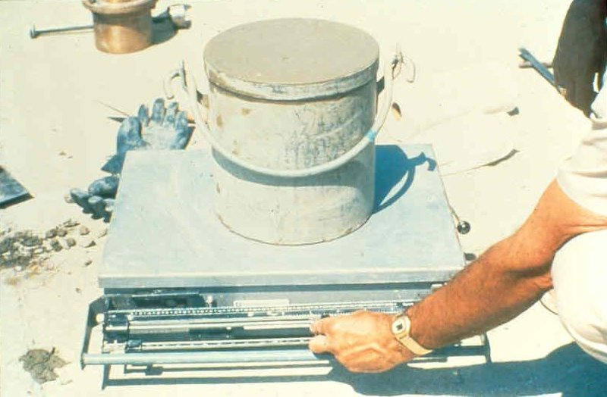
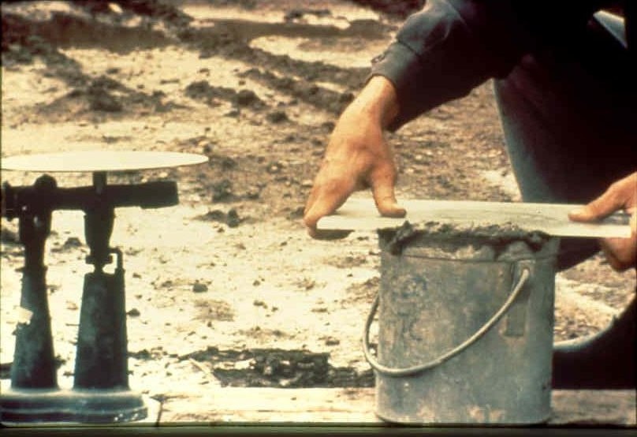

Slide 23
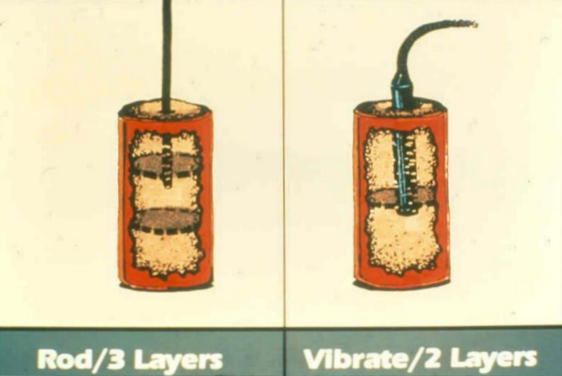
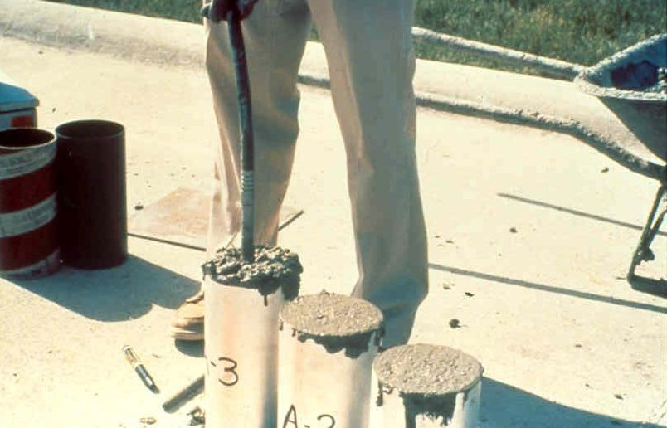
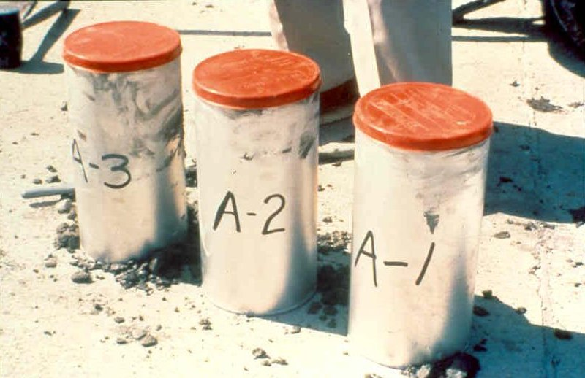
Strength Specimen
Preparation

Slide 24
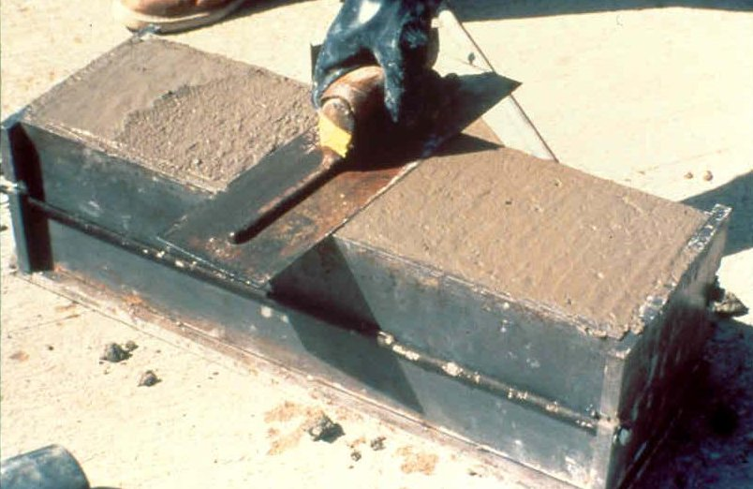
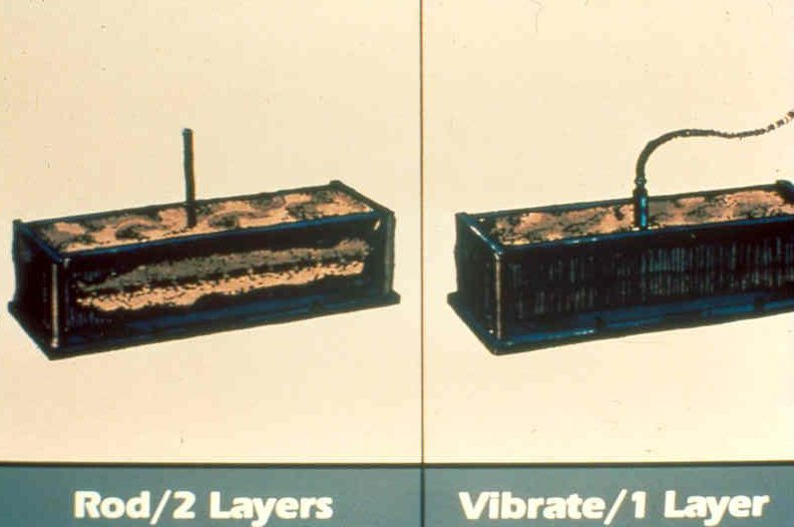
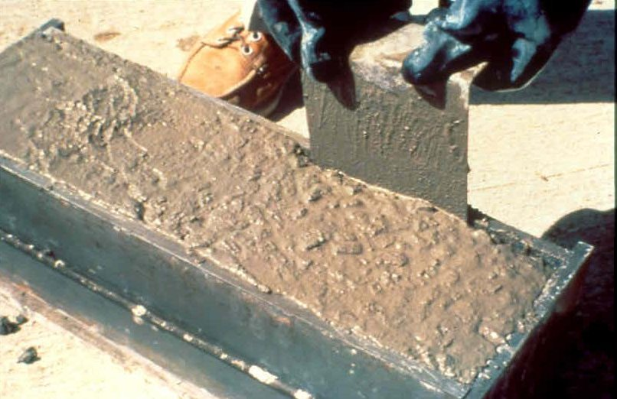
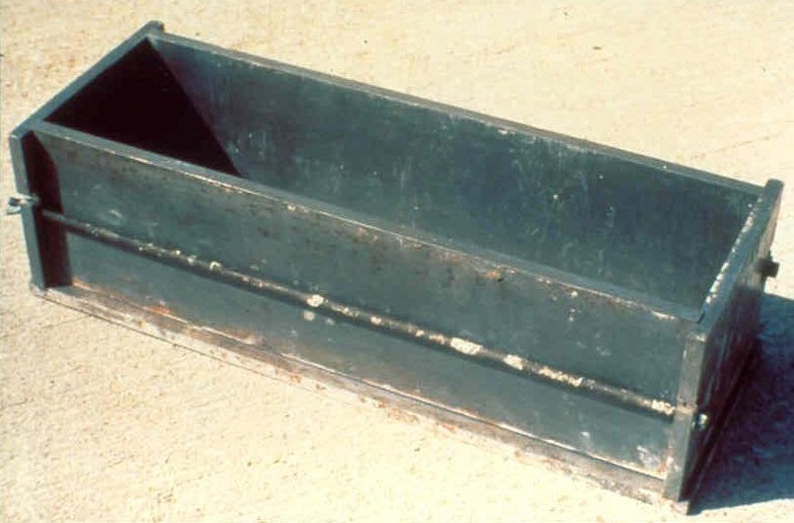

Slide 25
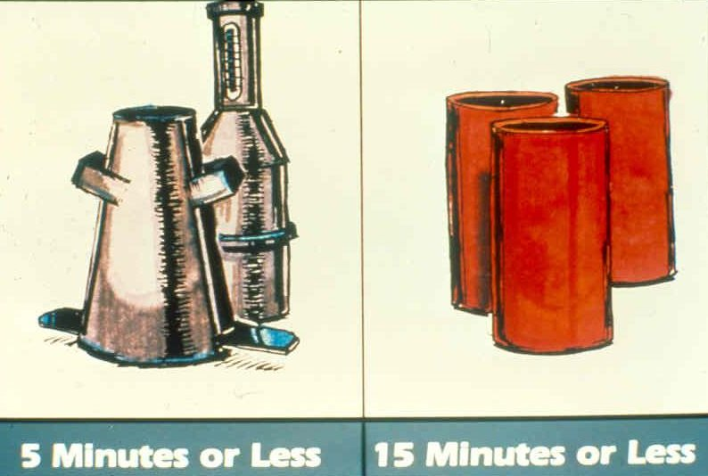
Slump, Air, and Cylinder Casting

Slide 26
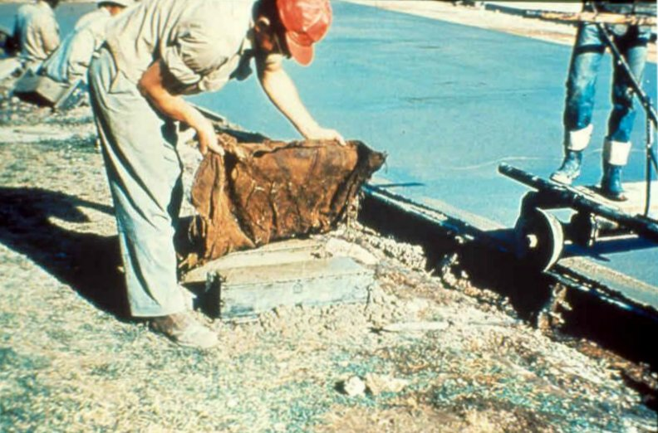
Curing

